Slide 1











GOOGLE PLAYSTORE
DATA ANALYSIS !
PRINCE SARKAR

Slide 2




OBJECTIVE
The objective of this project is to gain insights into the applications hosted on Google Playstore and the sentiment of their user reviews and present these insights in the form of visualisation which can be used to improve the overall experience and optimise the application development processes.
PRINCE SARKAR
MAY 25

Slide 3



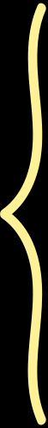
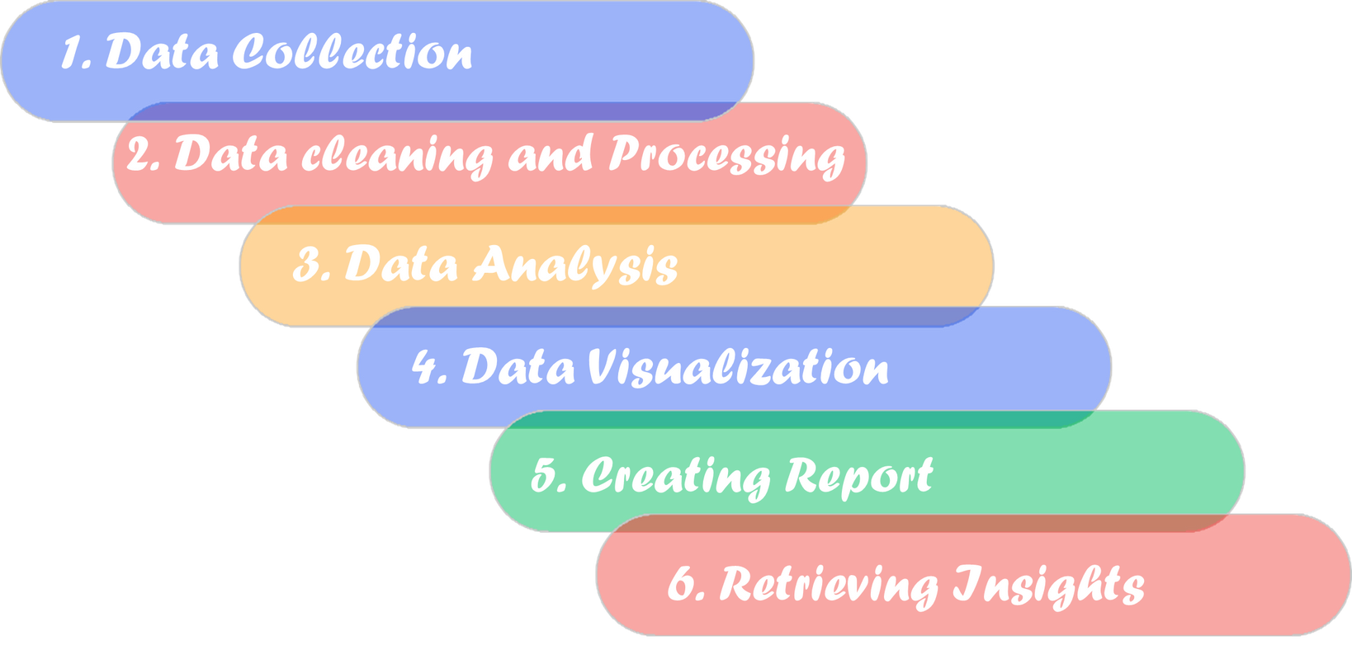
STEPS INVOLVED

Slide 4

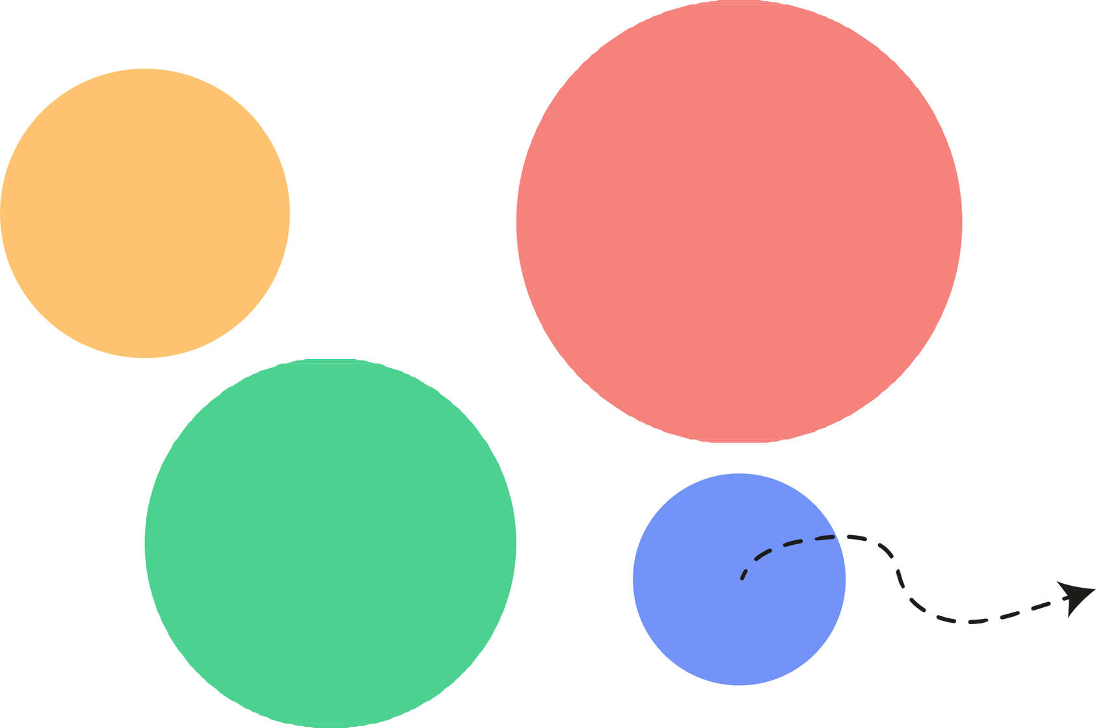




CHARTS USED IN THE REPORT AND KEY INSIGHTS !

Slide 5

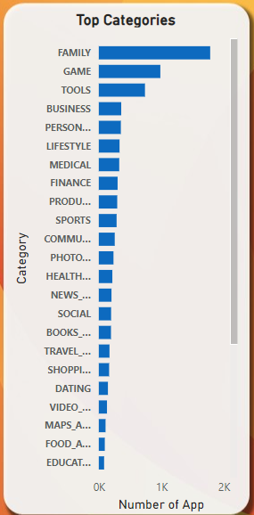


CLUSTERED BAR CHART
In the clustered bar chart analyzing Google Play Store apps, the "Family" category emerged as the leading category with the highest number of apps. This indicates a strong focus on family-oriented applications within the Play Store, highlighting the platform's commitment to providing diverse and extensive content for all age groups.

Slide 6
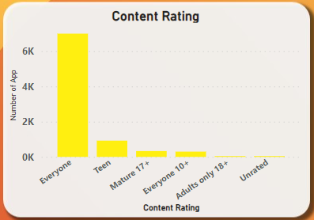
STACKED COLUMN CHART
The stacked column chart of Google Play Store apps reveals that the majority of apps are rated "Everyone," with over 6,000 apps falling into this category. This dominance underscores the platform's emphasis on providing widely accessible content suitable for all age groups. Other content ratings, such as "Teen," "Mature 17+," "Everyone 10+," and "Adults only 18+," have significantly fewer apps, indicating a smaller proportion of age-restricted content on the Play Store.

Slide 7
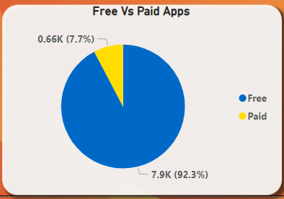

PIE CHART
The pie chart of Google Play Store apps illustrates a significant predominance of free apps, comprising 92.3% (7.9K) of the total. In contrast, paid apps make up only 7.7% (0.66K) of the available apps. This highlights the platform's strong emphasis on offering free content to users, making it accessible to a broader audience. The relatively small proportion of paid apps indicates limited reliance on direct purchase models within the Play Store.

Slide 8



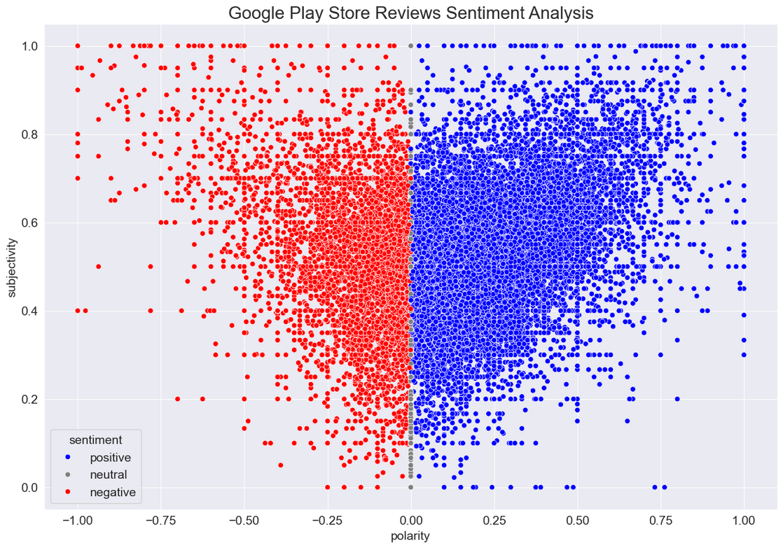
SENTIMENT ANALYSIS
The scatter plot visualizing Google Play Store reviews sentiment analysis shows a clear division between positive (blue) and negative (red) sentiments based on polarity. Reviews with positive sentiment are clustered on the right side, while negative sentiments dominate the left. This distribution highlights the strong presence of both positive and negative feedback among users, indicating diverse experiences and opinions about the apps available on the Play Store.

Slide 9
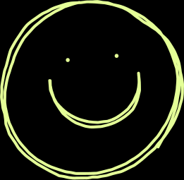
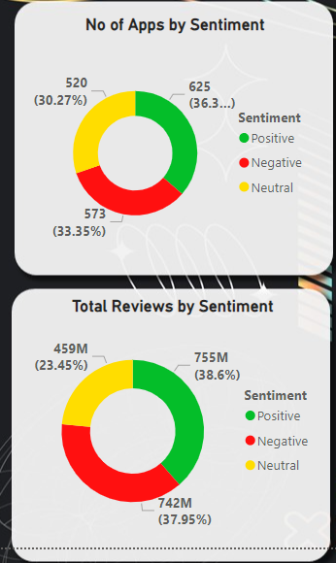
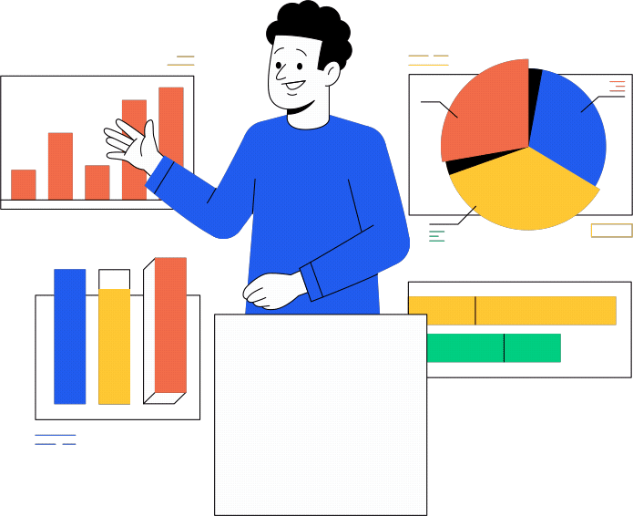

SENTIMENT ANALYSIS
The donut charts comparing the number of apps by sentiment and the total reviews by sentiment reveal insightful trends. For the number of apps, 36.3% (625 apps) have positive reviews, 33.35% (573 apps) have negative reviews, and 30.27% (520 apps) have neutral reviews, showing a fairly balanced sentiment distribution among apps.
In contrast, the total reviews by sentiment show that 38.6% (755M reviews) are positive, 37.95% (742M reviews) are negative, and 23.45% (459M reviews) are neutral. This indicates that while a similar proportion of apps receive positive and negative reviews, positive reviews slightly edge out the others in volume, suggesting that positive experiences tend to generate more feedback from users.

Slide 10


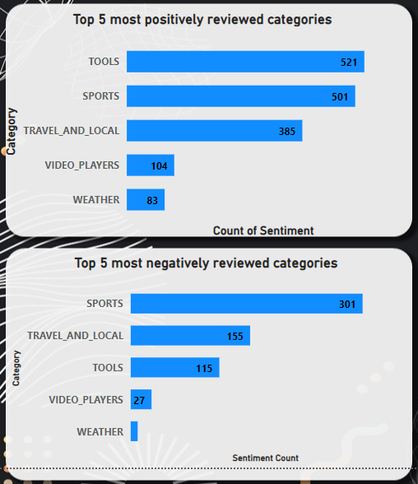

STACKED BAR CHART
The bar charts present the top 5 most positively and negatively reviewed app categories on the Google Play Store. In the positive sentiment chart, "Tools" leads with 521 positive reviews, followed closely by "Sports" with 501 reviews. "Travel and Local" (385), "Video Players" (104), and "Weather" (83) also feature prominently, highlighting these categories as highly appreciated by users.
In contrast, the negative sentiment chart shows "Sports" with the highest number of negative reviews (301), indicating mixed user experiences. "Travel and Local" (155), "Tools" (115), "Video Players" (27), and "Weather" (1) follow, suggesting these categories also attract significant criticism alongside their positive feedback. This dual analysis underscores the nuanced reception across different app categories.

Slide 11
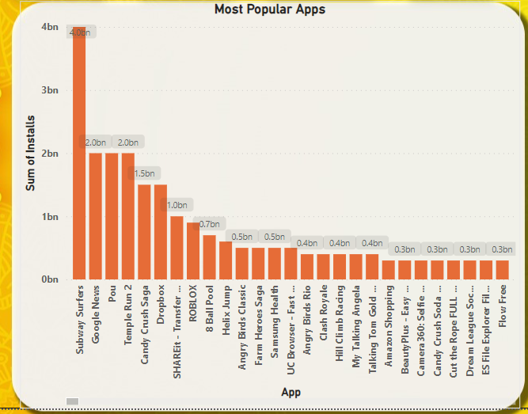
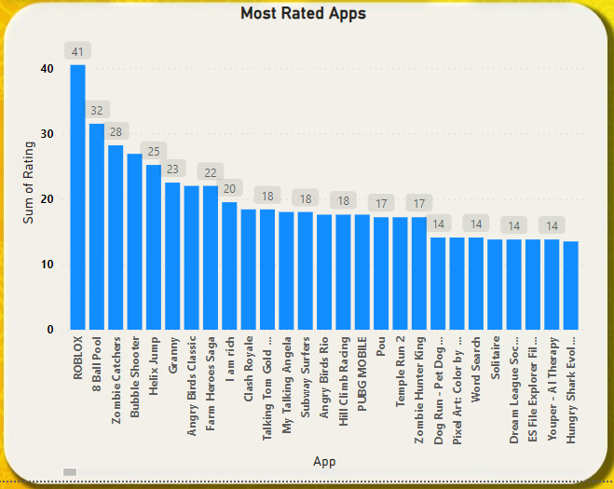


The first chart illustrates the most popular apps on the Google Play Store based on the number of installs. "Subway Surfers" leads with a staggering 4 billion installs, followed by "Google News" and "Pou," each with 2 billion installs. Other notable apps include "Temple Run 2" and "Candy Crush Saga," indicating a strong preference for games and news among users.
The second chart showcases the most rated apps on the Google Play Store, highlighting user engagement and satisfaction. "ROBLOX" tops the list with 41 million ratings, followed by "8 Ball Pool" with 32 million and "Zombie Catchers" with 28 million. This chart indicates that games, particularly multiplayer and casual games, receive the highest number of user ratings, reflecting their widespread popularity and active user bases.

Slide 12


THANK YOU

